Slide 1
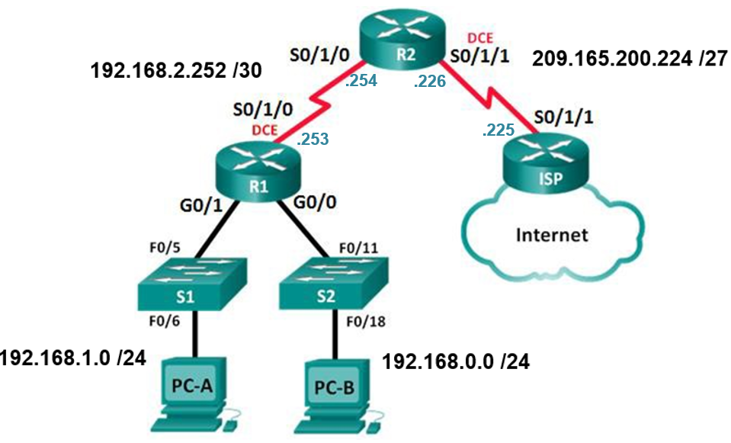
Lab 3. Configuring Basic DHCPv4 on a Router

